Slide 1
MBTA Update on Current Accessibility Initiatives
Highlights from June-November 2017
December 6, 2017

Slide 2
ITHAI LARSEN

Slide 3
BACKGROUND
Original Initiatives drafted in May 2015
Selected based on:
Customer feedback
Commitments within MBTA/BCIL Settlement
Funding availability
Updates will be drafted and shared every 6 months
Last issued on November 30, 2017
New initiatives added as additional priorities identified and resources become available

Slide 4
OVERVIEW
Over 200 million dollars of projects underway the improve access
Wollaston
Numerous station designs
Bus stop improvements
500+ people received travel training
AFC 2.0 RFP final and funded
Innovative Bluetooth beacon projects underway
Wayfinding at bus stops
App to convert info on visual displays to audio
nnn
gg
nnn

Slide 5
Plan for Accessible Transit Infrastructure (PATI)
g
nnn

Slide 6
PATI | PLAN FOR ACCESSIBLE
TRANSIT INFRASTRUCTURE
WHAT IS THE GOAL OF PATI?
Identify all meaningful barriers to accessibility and develop a long-term plan for achieving a fully accessible system using priorities developed with community input.

Slide 7
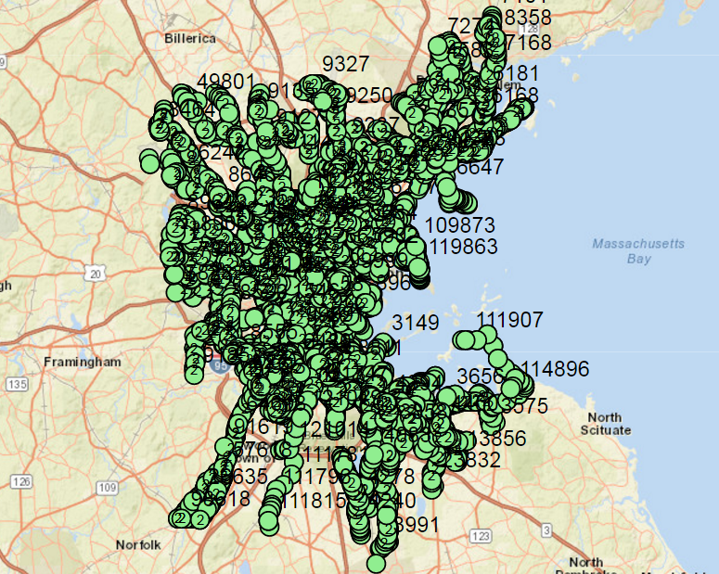
PATI | BUS STOP SURVEYS
51
Towns
184
Routes
7685
Bus Stops

Slide 8
PATI | BUS STOP SURVEYS
Of 7685 Stops Surveyed:
50% Are within 25 feet of a crossing
16% Are missing a front sign
14% Are located near a crossing with a missing curb ramp
13% Are located near a crossing with a curb ramp with a running slope greater than 12%
8% Have a shelter
7% Have a bench present (outside shelters)
7% Are located on a sidewalk less than 36” wide
3% Identified Critical
2% Have amenities blocking sidewalk

Slide 9
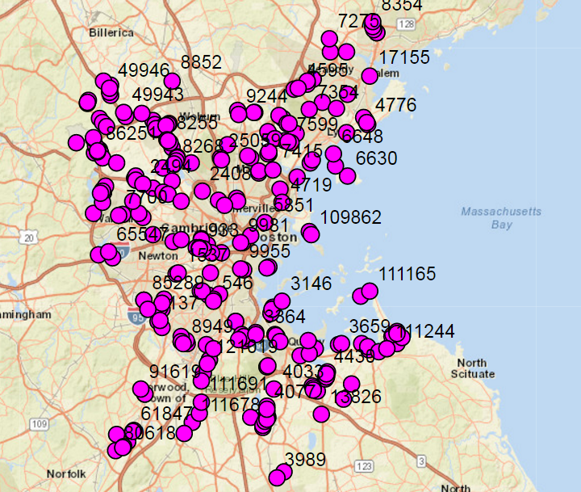
PATI | BUS STOP SURVEYS
Identified Critical: 278
What is a Critical Stop?
Barriers so significant that boarding/exiting from street is required
These were determined in field by survey crews

Slide 10
PATI | CRITICAL STOPS
Identified Critical: 278
209 reviewed internally
69 pending internal review
Of those 209 reviewed internally:
79 will be removed
130 will be rebuilt Spring 2018
Of those 69 pending internal review: 54 recommended for modifications
14 recommended for elimination
Washington St. at Rockhill St. Norwood

Slide 11
PATI | CRITICAL STOPS
Stop Solutions:
Bus stop lengthening – to allow both doors to be aligned with sidewalk
New accessible curb ramps
New sidewalks – to address/eliminate obstacles
Safer pedestrian crossings
New bus pavement markings
New bus landing pads
New and improved bus stop signage

Slide 12
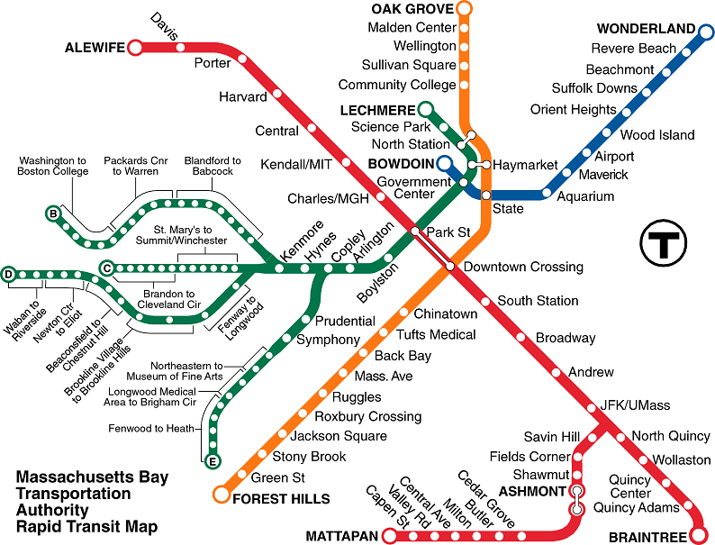
PATI | STATION SURVEYS
178*
Stations
17,664
Elements
*Not all stations were surveyed

Slide 13
PATI | SETTING PRIORITIES
Recommendations to be made:
How much should the MBTA spend on accessibility upgrades at Bus vs. Subway vs. Commuter Rail Stations?
Should we prioritize full station upgrades vs. upgrading individual elements across the system, such as:
Accessible Parking
Detectable Warnings
Call Boxes
Should feasibility and cost be a factor in these considerations?

Slide 14
Elevator Updates
g
nnn

Slide 15
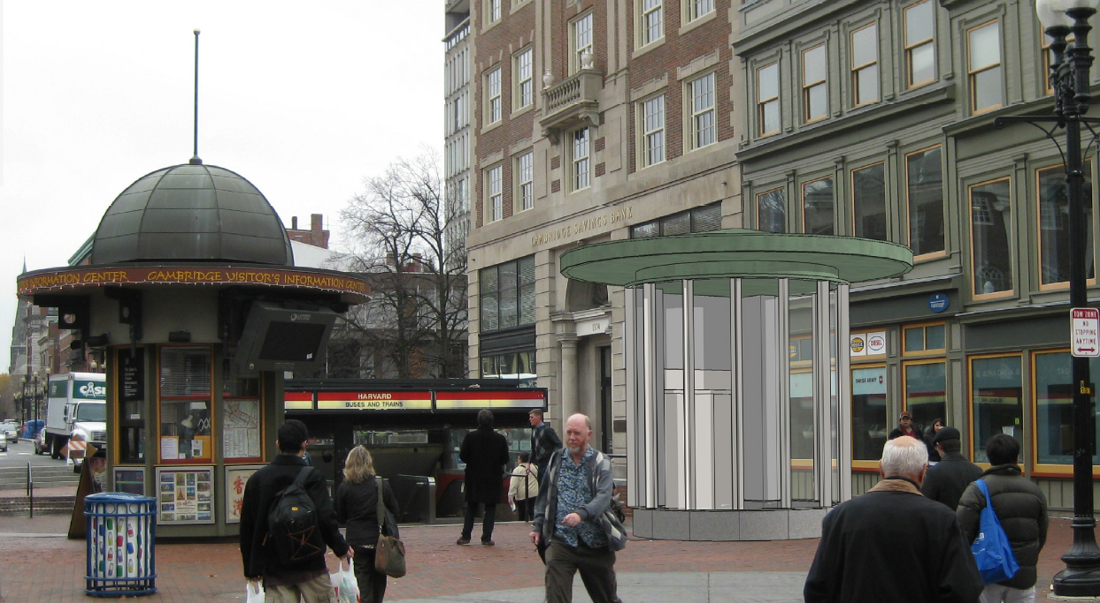
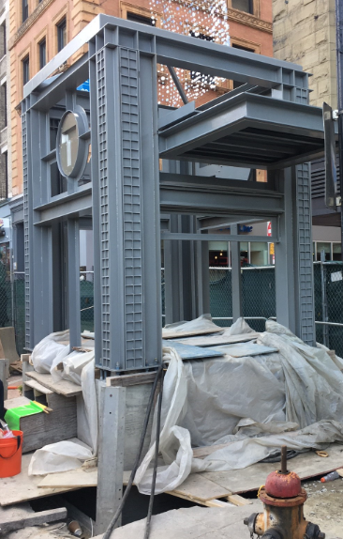
ELEVATOR UPGRADES IN CONSTRUCTION (19 Elevators)
Park St 804
Havard 821
Central 861
Downtown Crossing Phase I (2)
Tufts 872, 879, 880
Andrew 857, 858, 859
Alewife 813, 814, 815
Ruggles (5)

Slide 16
ELEVATOR UPGRADES IN DESIGN (71 Elevators in Total)
The following 19 elevators will be included as part of larger station improvement projects.
Broadway (4)
Chinatown (4)
State Street (OL) (4)
Sullivan Square (5)
Downtown Crossing, Phase II (2)

Slide 17
ELEVATOR UPGRADES IN DESIGN (69 Elevators in Total)
The remaining 52 elevators will be stand-alone vertical transportation projects.
Red Line: Davis Square (5), Central Square (3), Quincy Adams (4), Park Street (1)
Orange Line: Mass Ave (2), Jackson Square (2), Tufts (3), Wellington (4)
Green Line: North Station (2), Fenway (2), Arlington (3), Prudential (6)
Blue Line: Wood Island (2), Beachmont (4)
Silver Line: Courthouse (4)
Commuter Rail: Framingham (2), Readville (3)

Slide 18
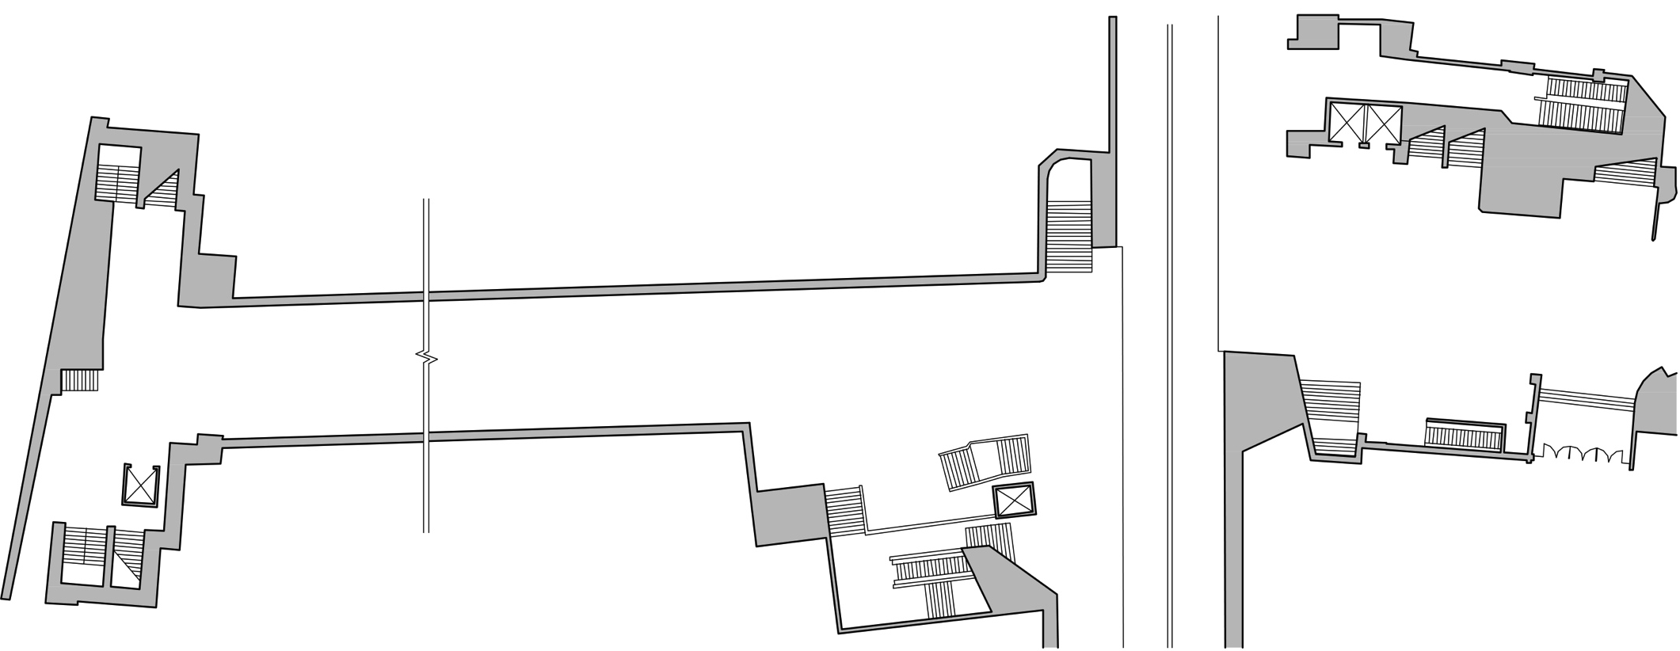
DOWNTOWN CROSSING (DTX)
DTX Phase I Elevators
Orange Line Southbound to Forest Hills
DTX Phase III New Park Street
Elevator #808
Orange Line Northbound to Oak Grove
Summer Street Concourse
Winter Street Concourse
Park St. Elevator #804
DTX Phase II Elevators

Slide 19
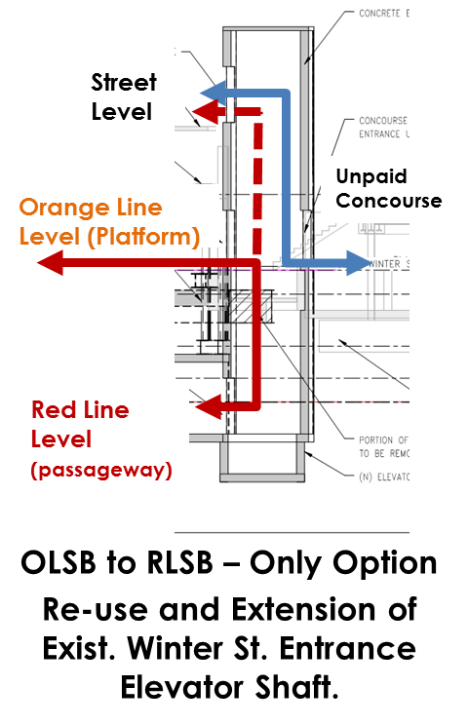
DOWNTOWN CROSSING (DTX)
DTX Phase II:
OLSB/RLSB Elevator at Washington Street/Winter Street
Connects RL and OL
Exits at street level
Enter at street to OL unpaid concourse
OLNB/RLSB Elevator at Macy’s
- Connects RL and OL
DTX Phase III:
OLSB to RLNB Elevator
Corner Mall location not feasible (per Eversource)
Exploring feasibility to connect RLSB to OLNB via Park Street Station by enlarging and relocating Elevator 808 (towards Downtown Crossing)
OL Southbound/RL Southbound Elevator at Washington Street/ Winter Street Entrance

Slide 20
New Vehicles
g
nnn

Slide 21
375 NEW LOW-FLOOR BUSES
All are in service
MBTA will be testing new battery buses for potential Silver Line/Airport use
MBTA pursuing additional bus procurements in quantities TBD

Slide 22
RED, ORANGE & GREEN LINE CARS
24 Type 9 Green Line Cars
Pilot car in service 2018
GL Type 10 Green Line RFP process starts FY19
252 Red Line cars & 152 Orange Line Cars are ordered
Orange Line pilot test cars arrive December 2017!

Slide 23
Bus Shuttles During Diversions
g
nnn

Slide 24
BUS SHUTTLES DURING DIVERSIONS
Due to many construction projects, numerous diversions
3rd party needed to help supply buses and drivers
Vehicles will be accessible, but many will have lifts, not ramps
Upcoming RFP
Contact us if any problems

Slide 25
QUESTIONS/COMMENTS
QUESTIONS/COMMENTS

